Slide 1



Fleche: An Efficient GPU Embedding Cache for Personalized Recommendations
Minhui Xie, Youyou Lu, Jiazhen Lin,
Qing Wang, Jian Gao, Kai Ren, Jiwu Shu
Tsinghua University
Kuaishou

Slide 2






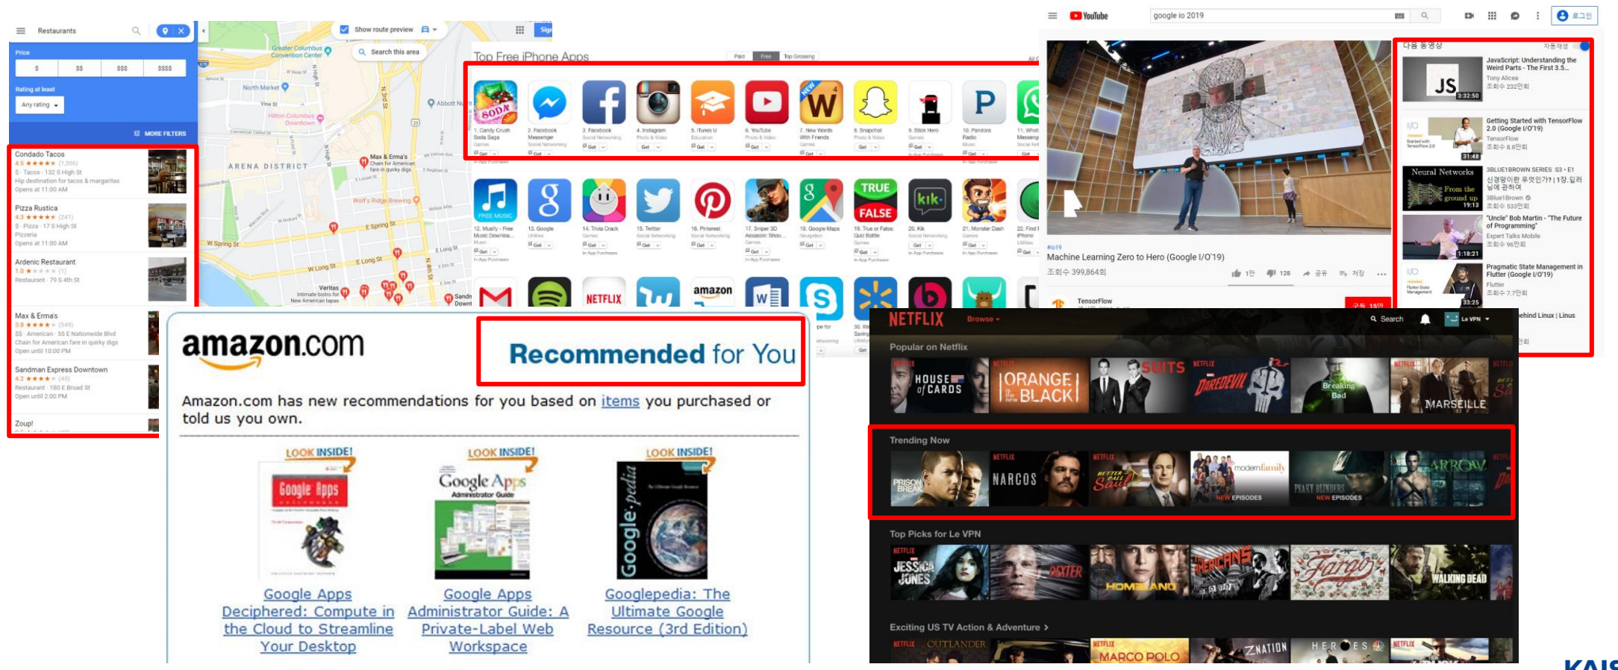
Personalized recommendations are everywhere
Information explosion
Over 500M new tweets sent every day
Over 500 hours of video uploaded to YouTube every minute
At Kuaishou, users generate more than 10M fresh UGC every day
Recommendation system
Selecting items users may like best from warehouse
Directly driving
80% movies watched on Netflix
60% videos clicks on YouTube
35% Amazon revenue

Slide 3
Recommendation inference at datacenter scale
Deep Learning based Recommendation Model (DLRM) accounts for over 80% of all AI inference cycles in Facebook’s datacenter. *
AI inference cycles in Facebook’s datacenter
It is important to improve the performance of recommendation inference.
* Gupta et. al., “The Architecture Implications of Facebook’s DNN-based Personalized Recommendation Models” [HPCA’2020]

Slide 4

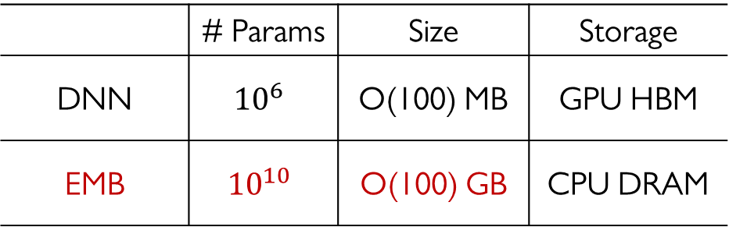
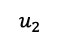

DLRM architecture
Label
Embedding Lookup
Fully-Connected
Fully-Connected
Embedding Vector
( or embedding for short)
ID
Embedding Table
...
$$u_{2}$$
(stored as hash-table)
...
Fully-Connected
Pooling
Pooling
Embedding Tables (EMB)
 | # Params | Size | Storage
DNN | $${10}^{6}$$ | O(100) MB | GPU HBM
EMB | $${10}^{10}$$ | O(100) GB | CPU DRAM
Fully-Connected
User Emb Tb
Video Emb Tb
[$u_{2}$]
[$v_{2}, v_{4}$]
Age
# videos watched
User ID
Like Video IDs
Continuous Features
Categorical Features

Slide 5
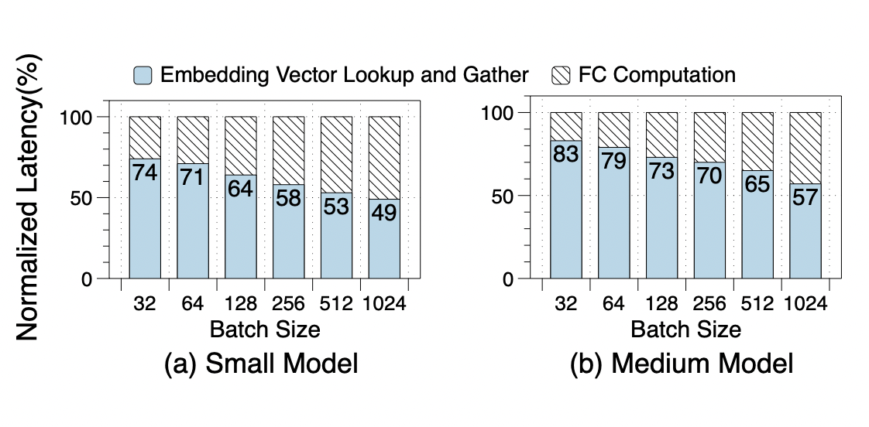
Embedding bottleneck
Irregular DRAM access in EMB has become the major impediment of DLRM
Over 50% latency is spent on EMB in Alibaba’s two production models
This is because
Application: the increase of features and feature categories for higher accuracy.
Hardware: DNN can enjoy the benefits of GPU’s increasing computing power.
Bandana (MLSys’18)
RecNMP (ISCA’20)
MicroRec (MLSys’21)
HET (VLDB’22)
TensorDIMM (MICRO’19)
MERCI (ASPLOS’21)
FleetRec (KDD’21)
RecShard (ASPLOS’22)

Slide 6
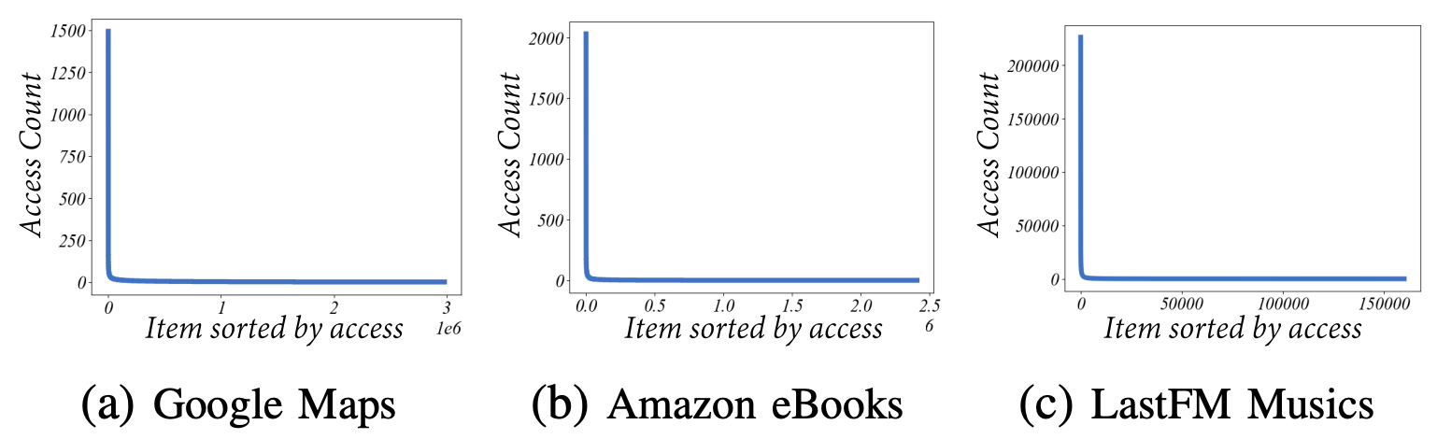
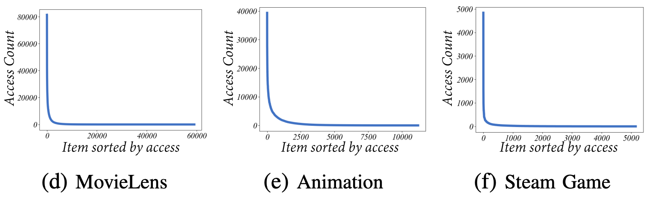
Alleviating embedding bottleneck
Embedding cache: caching hot embeddings on GPU
Workload hotspots
Datacenter GPU utilization
Modern workloads always feature skewed access patterns*
Abundant GPU memory resources in our inference cluster
* H. Kal et. al., SPACE: Locality-Aware Processing in Heterogeneous Memory for Personalized Recommendations," [ISCA’2021]

Slide 7

Alleviating embedding bottlenecks
NVIDIA HugeCTR Inference
GPU-resident EMB cache
Enjoys over 5x performance improvement than no-cache one
Maintains a static per-table cache scheme
GPU-HBM
Cache
Tables
……
C ₀
^{C} n-1
K ₀
……
^{K} n–1
Kernels
CPU-DRAM
Full Tables
……
E ₀
^{E} n–1
However, the existing cache solution is not yet able to exploit the benefits offered by GPU-resident cache.
Output Matrixes
……
O ₀
^{O} n–1

Slide 8
Existing embedding cache solution
Issue 1: Cache under-utilization
Per-table cache only captures local hotspots
Static table cannot rescale for hotspot size changing
Issue 2: Kernel maintenance overhead
Maintenance overhead (e.g., launching, context initialization, synchronizing)
Excessive small query kernels
(proportional to # of EMB tables)
Maintenance time > execution time
Optimal knows all data access trace
29%
42%
The total number of queried keys is 10K
0
70%
Usually,
# of EMB tables > 60
in production models

Slide 9
Outline
Background & Motivation
Fleche: An Efficient GPU Embedding Cache for Recommendations
Evaluation
Conclusion

Slide 10

Key Idea
HugeCTR:
Static per-table cache scheme
Fleche:
Global sharing cache scheme
Sharing one global cache backend for all embedding tables
GPU-HBM
ID_List 0
ID_List n-1
ID_List 0
ID_List 1
……
ID_List n-1
Fusing small query kernels to reduce maintenance overhead
Cache
Tables
……
Issue 1: cache under-utilization
Cache Tbl 0
Cache Tbl 1
Cache Tbl n-1
C ₀
^{C} n-1
Flat Cache
Addressing Issue 1
Kernels
……
K ₀
^{K} n–1
Issue 2: maintenance overhead of small kernels
Self-identified kernel fusion
Addressing Issue 2
CPU-DRAM
Full Tables
……
……
E ₀
^{E} n–1
E ₀
^{E} n–1

Slide 11
I. Flat Cache (key idea)
Key idea
Accommodate all embedding cache in one
physical cache backend
Shim layer: flat keys
Re-encode feature IDs from different
EMB tables to flat keys
Flat Cache is unaware of multi-EMB
Advantage
As a cache backend for all EMB tables, Flat
Cache captures global hotspots
The physical admission and eviction of flat
keys makes cache tables rescale logically
ID_List 0
ID_List 1
……
ID_List n-1
Flat Keys
Cache Tbl 0
Cache Tbl 1
Cache Tbl n-1
Flat Cache
Full Tables in CPU-DRAM
……

Slide 12
I. Flat Cache (details) - re-encoding feature IDs
Avoid key conflicts across EMB tables
ID_List 0
ID_List 1
……
ID_List n-1
ID 212
Flat Keys
User EMB Tbl
Conflicts
one flat key
Cache Tbl 0
Cache Tbl 1
Cache Tbl n-1
ID 212
Flat Cache
City EMB Tbl
Naive method encounters severe hash collisions
Full Tables in CPU-DRAM
tbl id: 8-bit | feature id (hashed): 24-bit
……
Fleche: Size-aware encoding method
Table ID
Input IDs
Table 0 Output Emb
Table 1 Output Emb
Table n-1 Output Emb
Hashing
Storage cost : O(# of EMB tables)
Time cost : One dict lookup for all IDs of one EMB table
Encoding Dict
tbl id: variable-len feature id: variable-len
Check our paper for more details
Flat Keys

Slide 13
I. Flat Cache (details)
ID_List 0
ID_List 1
……
ID_List n-1
Flat Keys
Cache Tbl 0
Cache Tbl 1
Cache Tbl n-1
Flat Cache
Full Tables in CPU-DRAM
……

Slide 14
I. Flat Cache (details)
ID_List 0
ID_List 1
……
ID_List n-1
Decouple keys and EMB vectors
GPU-resident index
Memory pool
Minimize metadata storage cost
No size recorded
Timestamp also acts as a
version number for CC
Reduce swap-in-out cost of low-frequent features
Probability-based filter
Flat Keys
GPU-Resident Index (e.g., Slab Hash)
Filter
key1 |  | key2
timestamp |  | timestamp
ptr |  | ptr
Eviction
dim = 32
Memory Pool
dim = 64
dim = 128
Physically
Flat Cache
Full Tables in CPU-DRAM
……

Slide 15
II. Self-identified kernel fusion (key idea)
Observation
Most kernel launches are not calls to different kernel functions but to the same cache query function with different arguments
Key idea
Launch a kernel with sufficient threads and let each thread self-identify the original kernel and execute
Three-phase fusion
Kernel 0
Args
Kernel 1
Args
Kernel 2
Args
Cache Tables
0
0
0
1
1
1
2
2
2
with the same blockDim
C ₀
C ₁
C ₂
Cache Query Function

Slide 16
II. Self-identified kernel fusion (details)
Phase 1: Initialization
Init a prefix-sum array of kernel thread counts, Scan Array
Init an Args Array storing all query kernels’ parameters
H2D Scan Array and Args Array
动画
Kernel 0
Args 0
0
embedding dim
flat keys
output address
960 threads
0
Meta data H2D GDR-copy
0
Kernel 1
Args 1
Kernel 2
Args 2
1
2
Shared memory store meta data
1920 threads
1
640 threads
2
1
2
Warp divergence
Scan Array
Args Array
◆ Initialization
0
1
2
[0, 960, 2880, 3520]
0
1
2
0
1
2

Slide 17
II. Self-identified kernel fusion (details)
Phase 1: Initialization
Init a prefix-sum array of kernel thread counts, Scan Array
Init an Args Array storing all query kernels’ parameters
H2D Scan Array and Args Array
动画
Kernel 0
Args 0
0
embedding dim
flat keys
output address
960 threads
0
Meta data H2D GDR-copy
0
Kernel 1
Args 1
Kernel 2
Args 2
1
2
Shared memory store meta data
1920 threads
1
640 threads
2
1
2
Warp divergence
Args Array
◆ Initialization
0
1
2
0
1
2
0
1
2
Scan Array
[0, 960, 2880, 3520]

Slide 18
II. Self-identified kernel fusion (details)
Phase 1: Initialization
Init a prefix-sum array of kernel thread counts, Scan Array
Init an Args Array storing all query kernels’ parameters
H2D Scan Array and Args Array
Launch a unitary kernel with Scan[n] threads
动画
Kernel 0
Args 0
0
embedding dim
flat keys
output address
960 threads
0
Meta data H2D GDR-copy
0
Kernel 1
Args 1
Kernel 2
Args 2
1
2
Shared memory store meta data
1920 threads
1
640 threads
2
1
2
Warp divergence
One Unitary Kernel
Args Array
◆ Initialization
…
0
1
2
3520 threads
0
1
2
0
1
2
Scan Array
[0, 960, 2880, 3520]

Slide 19
II. Self-identified kernel fusion (details)
Phase 1: Initialization
Init a prefix-sum array of kernel thread counts, Scan Array
Init an Args Array storing all query kernels’ parameters
H2D Scan Array and Args Array
Launch a unitary kernel with Scan[n] threads
Phase 2: Identification (in kernel)
Get thread ID, tid
Binary search Scan Array with tid, find k s.t.
Scan[k] <= tid < Scan[k+1]
Thread tid → (tid-Scan[k])th thread of kernel k
Phase 3: Execution (in kernel)
Get args from Args Array[k]
Execute as (tid-Scan[k])th thread of kernel k
Kernel 0
Args 0
0
embedding dim
flat keys
output address
960 threads
0
0
Kernel 1
Args 1
Kernel 2
Args 2
1
2
1920 threads
1
640 threads
2
1
2
One Unitary Kernel
Args Array
Phase 1 & 2 enjoy low overhead with GDR-optimized H2D copy and GPU shared memory
◆ Initialization
…
0
1
2
3520 threads
0
1
2
0
1
2
Scan Array
[0, 960, 2880, 3520]
Binary Search
❖ Identification
tid=1500 φ=1
No warp divergence although binary search
Kernel 0
Kernel 1
Kernel 2
⬥ Execution
Args 0
Args 1
Args 2
0
1
2
0
1
2
0
1
2

Slide 20
III. Optimizing the workflow of cache query
Naïve
HBM EMB
Index & Copy
DRAM EMB
Index & Copy
Index & Embedding Copy
Index
Unified Index
GPU
HBM
Parallel
Hit keys
Parallel
Hit keys
Decoupling copying from indexing
Embedding Copy
Embedding Copy
HBM Copy
Missing keys
Missing keys
& locations
HBM EMB
Index
DRAM EMB
Index & Copy
Index & Embedding Copy
Index & Embedding Copy
Partial Index &
Embedding Copy
CPU
DRAM
Bypassing indexing of CPU-DRAM layer
HBM Copy
Decoupling copying
from indexing
Bypassing indexing
of CPU-DRAM layer
HBM
Unified Index
DRAM EMB
Index & Copy
Naïve
Time

Slide 21
Outline
Background & Motivation
Fleche: An Efficient GPU Embedding Cache for Recommendations
Evaluation
Conclusion

Slide 22
Experimental setup
Hardware Platform
CPU | 2 * Intel Xeon Gold 6252 CPUs, 32 cores per node
DRAM | 8 * 64 GB DDR4 DIMMs (4 per node)
GPU | NVIDIA Tesla T4 (16GB memory available)
Model: Deep Cross Network (same config in the original paper)
Real-world Datasets
 | # of Emb Tables | # of Samples | # of Sparse IDs | Param Size
Avazu | 22 | 40M | 49M | 5.8GB
Criteo-Kaggle | 26 | 40M | 34M | 4.1GB
Criteo-TB | 26 | 4.4B | 0.9B | 461GB
Synthetic Dataset
40 Emb tables with 0.25M IDs per table; Power law ($α=−1.2$)

Slide 23

Overall performance
Cache ratio: 5%
Throughput (items/s)
Batch size
Fleche yields much better performance than HugeCTR in end-to-end inference
1.2−2.1×, 1.4−2.4×, and 1.3−2.2× in Avazu, Criteo-Kaggle, and Criteo-TB
The less boost in large batch size is because the DNN part accounts for more

Slide 24

Embedding-only performance under different cache sizes
Cache ratio:
Embedding Speedup
Over HugeCTR
Batch size
Fleche yields much better embedding performance under different cache sizes
1.9−3.8×, 2.4−5.3× and 3.9−5.8× in Avazu, Criteo-Kaggle and Criteo-TB

Slide 25
Revisit our motivation
Issue 1: Cache under-utilization
Issue 2: Kernel maintenance overhead
Optimal knows all data access trace
The total number of queried keys is 10K
27%
41%
15%
Fleche improves cache utilization with Flat Cache.
Fleche cuts out kernel maintenance overhead almost completely.

Slide 26
Breakdown
Cache ratio: 5%
Dataset: Avazu

Slide 27
Outline
Background & Motivation
Fleche: An Efficient GPU Embedding Cache for Recommendations
Evaluation
Conclusion

Slide 28
Conclusion
Problem
Existing embedding cache is inefficient for memory-bound DLRM
Motivation
Issue 1: Cache under-utilization
Issue 2: Kernel maintenance overhead
Key techniques of Fleche
Flat Cache (sharing all embedding cache in one backend to improve cache utilization)
Self-identified kernel fusion (alleviate maintenance overhead of small kernels)
Optimizing the workflow of cache query
Results
Fleche outperforms the state-of-the-art system HugeCTR-inference

Slide 29
Thanks & QA
Fleche: An Efficient GPU Embedding Cache for Personalized Recommendations
Contact Information: xmh19@mails.tsinghua.edu.cn

